Slide 1
Recap: Lecture 12: 6th Feb 2014, 0930-1030 hrs.
Carnot principles
Proof of the Carnot principles
Thermodynamic temperature scale

Slide 2
Quality of energy
High temperature
Source, T_{H}
T_{H}, K | η_{th}, %
1000 | 70
700 | 57.1
500 | 40
400 | 25
350 | 14.3
Q_{H}
Reversible HE
W_{net}
Q_{L}
Low temperature
Sink, T_{L}=300 K

Slide 3
Quality of energy
Energy has quality as well as quantity.
More of the high-temperature thermal energy can be converted to work.
The higher the temperature, the higher the quality of the energy.
Work is a high quality form of energy than heat since 100 percent of work can be converted to heat, but only a fraction of heat can be converted to work.

Slide 4
Carnot refrigerator and heat pump
Operates on a reversed Carnot cycle.
The coefficients of performance are:
These are the highest coefficients of performance that a refrigerator or a heat pump operating between the temperature limits of T_{L} and T_{H} can have.

Slide 5
Carnot refrigerator and heat pump

Slide 6
From thermodynamic temperature scale
Lord Kelvin proposed to define a
thermodynamic scale as

Slide 7
Clausius inequality
Thermal energy reservoir (T_{R})
δQ_{R}
Rev.
Cyclic
device
δW_{rev}
δQ
T
System
δW_{sys}
Combined system
(system and cyclic device)

Slide 8
Reversible adiabatics
Reversible
adiabatics
Process m-n
Q_{m-n} = U_{n} –U_{m} +W_{mn}
Process m-a-b-n
Q_{m-a-b-n}=U_{n} –U_{m}+W_{m-a-b-n}
Since, W_{m-a-b-n} = W_{mn}
Q_{m-n} = Q_{m-a-b-n}
= Q_{m-a}+ Q_{a-b} + Q_{b-n}
Since Q_{m-a} = 0, Q_{b-n} = 0
Q_{m-n} = Q_{a-b}
P
m
b
a
Reversible
isotherm
n
v
Reversible path can be substituted by two reversible adiabatics and a reversible isotherm

Slide 9
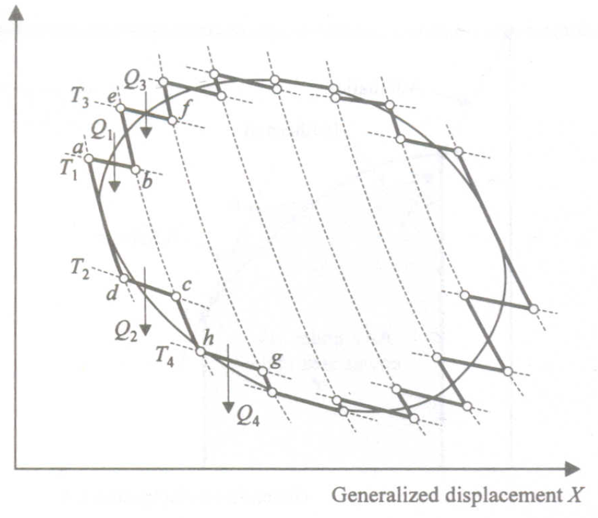
Generalized force Y

Slide 11
Clausius inequality
Applying the energy balance to the combined system identified by dashed lines yields: δW_{C} = δQ_{R} – dE_{C}
where δW_{C} is the total work of the combined system (δW_{rev}+δW_{sys}) and dE_{C} is the change in the total energy of the combined system.
Considering that the cyclic device is a reversible one

Slide 12
Clausius inequality
From the above equations:
Let the system undergo a cycle while the cyclic device undergoes an integral number of cycles
Since the cyclic integral of energy is zero.

Slide 13
Clausius inequality
The combined system is exchanging heat with a single thermal energy reservoir while involving (producing or consuming) work W_{C} during a cycle. Hence W_{C} cannot be a work output, and thus it cannot be a positive quantity.
Considering T_{R} to be a positive quantity,
This is the Clausius inequality.

Slide 14
Clausius inequality
Clausius inequality is valid for all thermodynamic cycles, reversible or irreversible, including the refrigeration cycles.
If no irreversibilities occur within the system as well as the reversible cyclic device, then the cycle undergone by the combined system is internally reversible.

Slide 15
Clausius inequality
Clausius inequality provides the criterion for the irreversibility of a process.

Slide 16
Clausius inequality and entropy
The cyclic integral of work and heat are not zero.
However, the cyclic integral of volume (or any other property) is zero.
Conversely, a quantity whose cyclic integral is zero depends on the state only and not the process path, and thus it is a property
Clausius realized in 1865 that he had discovered a new thermodynamic property, and he chose to name this property entropy.

Slide 17
The property of entropy
_{P}
_{a}
R₂
R₁
R₂
_{b}
R₁
R₂
R₁
_{V}
R₁
R₂

Slide 18
The property of entropy
is independent of the reversible path connecting a and b.
This property whose value at the final state minus the initial state is equal to is called entropy, denoted by S.
When the two equilibrium states are infinitesimally near,
R
R
R

Slide 19
Entropy
Entropy is an extensive property of a system and sometimes is referred to as total entropy. Entropy per unit mass, designated s, is an intensive property and has the unit kJ/kg·K
The entropy change of a system during a process can be determined by

Slide 20
Entropy
Entropy is a property, and like all other properties, it has fixed values at fixed states.
Therefore, the entropy change dS between two specified states is the same no matter what path, reversible or irreversible.

Slide 21
Temperature-entropy plot
A reversible adiabatic process is, therefore, and isentropic process.

Slide 22
Temperature-entropy plot
T
a
Reversible path
b
S_{a}
dS
S_{b}
S
The area under the reversible path on the T-S plot represents heat transfer during that process.

Slide 23
Isentropic processes
A process where, Δs=0
An isentropic process can serve as an appropriate model for actual processes.
Isentropic processes enable us to define efficiencies for processes to compare the actual performance of these devices to the performance under idealized conditions.
A reversible adiabatic process is necessarily isentropic, but an isentropic process is not necessarily a reversible adiabatic process.

